Slide 1


Academic Session 2025-26
ODD Semester Jul-Dec 2025
UNIVERSITY INSTITUTE OF COMPUTING
MASTER OF COMPUTER APPLICATIONS
DESIGN AND ANALYSIS OF ALGORITHMS
25 CAT 611
Unit No. 3 Chapter No. 3.2.2
Topic : Optimal binary search trees
Faculty Name and E_Code Dr. Sameera(17674) Designation: Asst. Professor

Slide 2

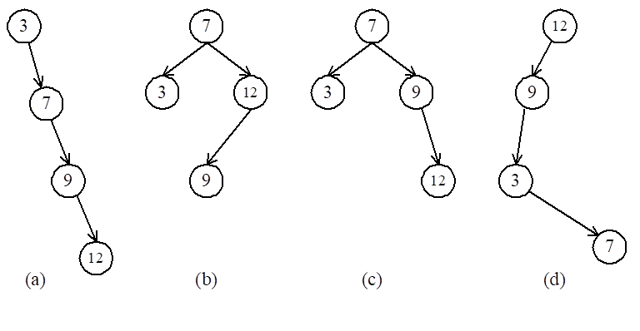
Optimal binary search trees
e.g. binary search trees for 3, 7, 9, 12;

Slide 3

Optimal binary search trees
n identifiers : a₁ <a₂ <a₃ <…< a_{n}
P_{i}, 1≤i≤n : the probability that a_{i} is searched.
Q_{i}, 0≤i≤n : the probability that x is searched
where a_{i} < x < a_{i+1} (a₀=-∞, a_{n+1}=∞).

Slide 4
Optimally Binary Search Tree
Identifiers : 4, 5, 8, 10, 11, 12, 14
Internal node : successful search, P_{i}
External node : unsuccessful search, Q_{i}
The expected cost of a binary tree:
The level of the root : 1

Slide 5
The dynamic programming approach
Let C(i, j) denote the cost of an optimal binary search tree containing a_{i},…,a_{j} .
The cost of the optimal binary search tree with a_{k} as its root :

Slide 6
Computation relationships of subtrees
e.g. n=4
Time complexity : O(n³)
when j-i=m, there are (n-m) C(i, j)’s to compute.
Each C(i, j) with j-i=m can be computed in O(m) time.

Slide 7
Matrix-chain multiplication
n matrices A₁, A₂, …, A_{n} with size
p₀ × p₁, p₁ × p₂, p₂ × p₃, …, p_{n-1} × p_{n}
To determine the multiplication order such that # of scalar multiplications is minimized.
To compute A_{i} × A_{i+1}, we need p_{i-1}p_{i}p_{i+1} scalar multiplications.
e.g. n=4, A₁: 3 × 5, A₂: 5 × 4, A₃: 4 × 2, A₄: 2 × 5
((A₁ × A₂) × A₃) × A₄, # of scalar multiplications:
3 * 5 * 4 + 3 * 4 * 2 + 3 * 2 * 5 = 114
(A₁ × (A₂ × A₃)) × A₄, # of scalar multiplications:
3 * 5 * 2 + 5 * 4 * 2 + 3 * 2 * 5 = 100
(A₁ × A₂) × (A₃ × A₄), # of scalar multiplications:
3 * 5 * 4 + 3 * 4 * 5 + 4 * 2 * 5 = 160

Slide 8
PRACTICE PROBLEM BASED ON 0/1 KNAPSACK PROBLEM-
Let m(i, j) denote the minimum cost for computing
A_{i} × A_{i+1} × … × A_{j}
Computation sequence :
Time complexity : O(n³)

Slide 9
References
https://webpages.uncc.edu › ras › courses › OB
Books:
Introduction to Algorithms by Coreman, Leiserson, Rivest, Stein.
Fundamentals of Algorithms by Ellis Horwitz
Computer Algorithms/C++ by Sartaj Sahni, Sanguthevar Rajasekaran

Slide 10
THANK YOU

